Slide 1
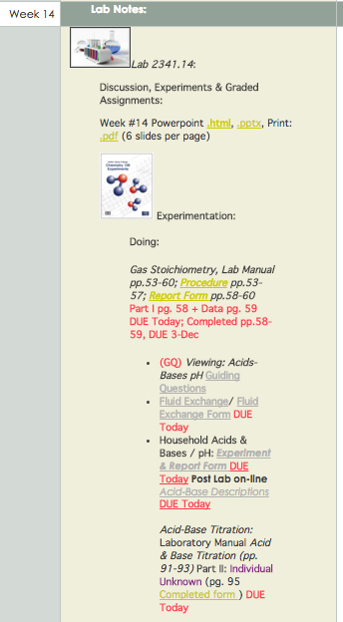
Chem 108: Lab
Week 14
Sign in
Note your Group #
Pick up Papers
and Handout

Slide 2
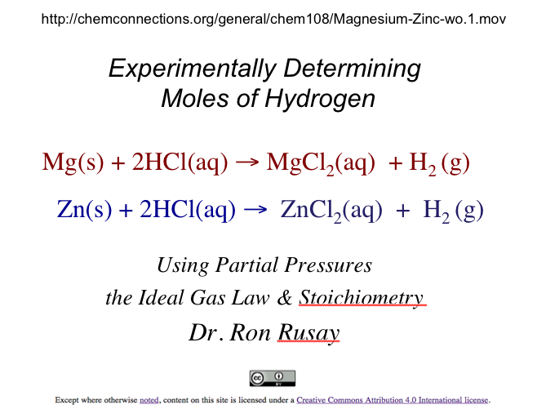
Gas Stoichiometry

Slide 3
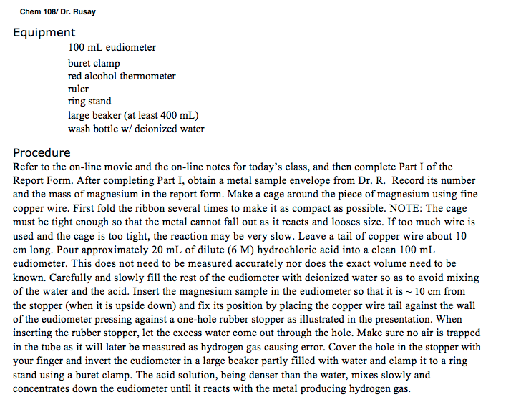
Refer to the Procedure section pp. 54-56. The following slides correspond to the instructions in the procedure.

Slide 4
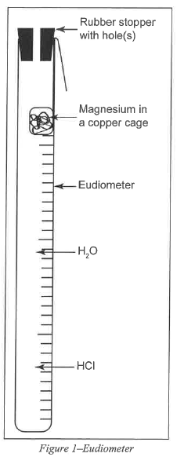
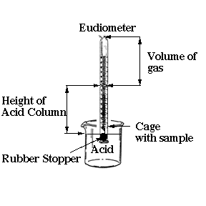

Slide 5
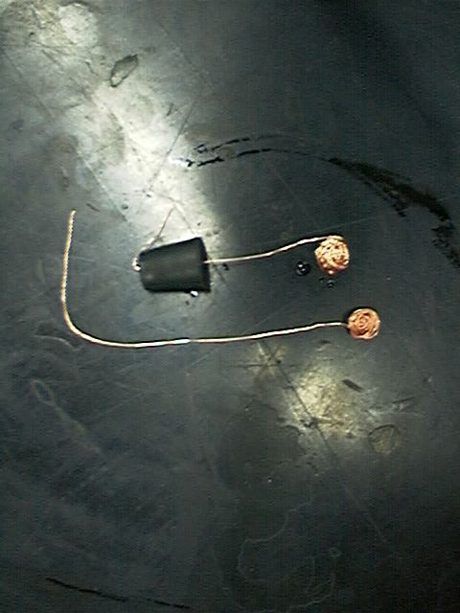
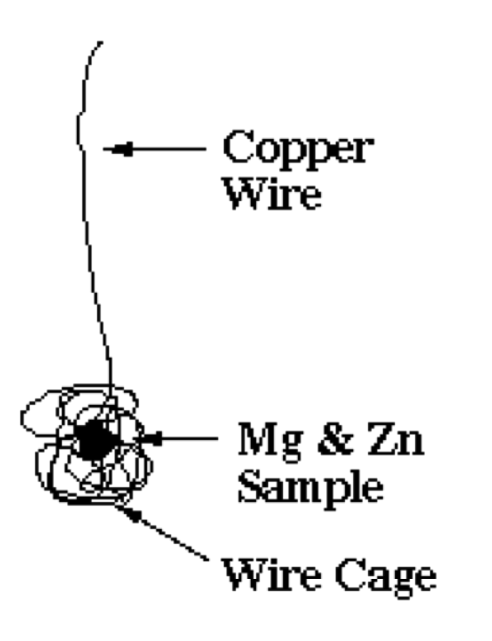
What is wrong with this set up?
Mg or Zn
Mg or Zn

Slide 6
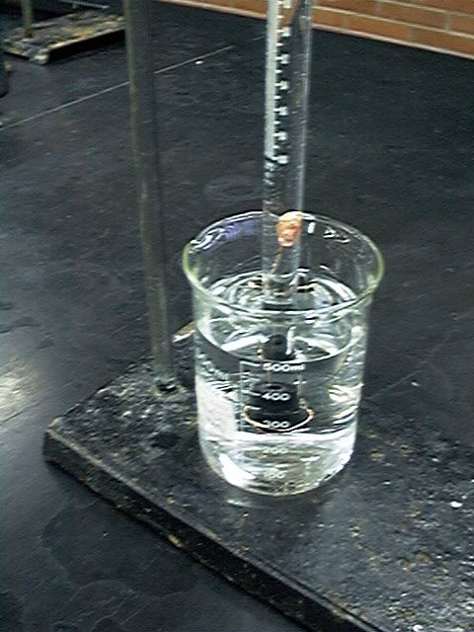
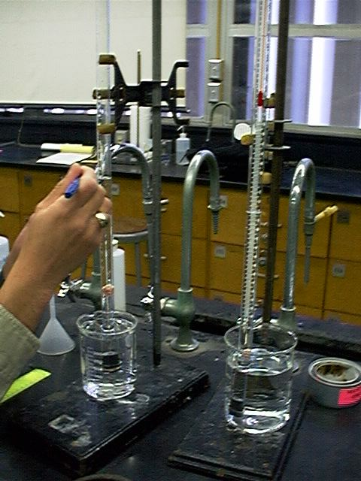
Mg(s) + 2HCl(aq) → MgCl₂(aq) + H₂ (g)
Zn(s) + 2HCl(aq) → ZnCl₂(aq) + H₂ (g)

Slide 7
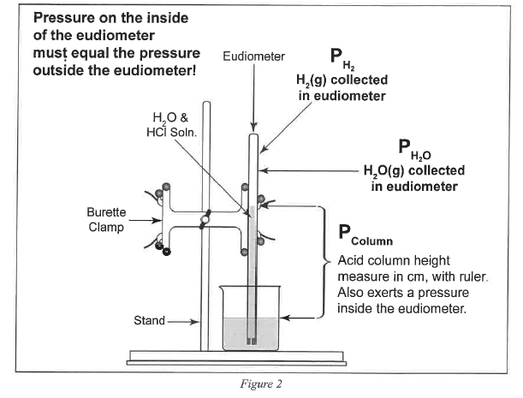
Mg or Zn

Slide 8
Refer to the Gas Stoichiometry Report Form, pg. 58-59
Experimental data is to be obtained for the reaction of a known mass of magnesium metal:
The volume of hydrogen, pressure and temperature determined and recorded.
Moles of hydrogen is calculated using Ideal Gas Law calculations, then calculating mass of the starting magnesium from the number of moles of hydrogen.
Mg(s) + 2HCl(aq) → MgCl₂(aq) + H₂ (g)

Slide 9
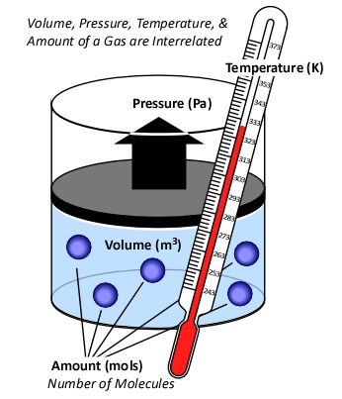
Background
Ideal Gas Law
PV = n RT
R = “proportionality” constant
  = 0.08206 L atm Κ⁻¹ mol⁻¹
P = pressure of gas in atm
V = volume of gas in liters
n = moles of gas
T = temperature of gas in Kelvin

Slide 10
Standard Conditions
Temperature, Pressure & Moles
“STP”
For 1 mole of a gas at STP:
P = 1 atmosphere
T = 0°C (273.15 K)
The molar volume of an ideal gas is 22.42 liters at STP

Slide 11
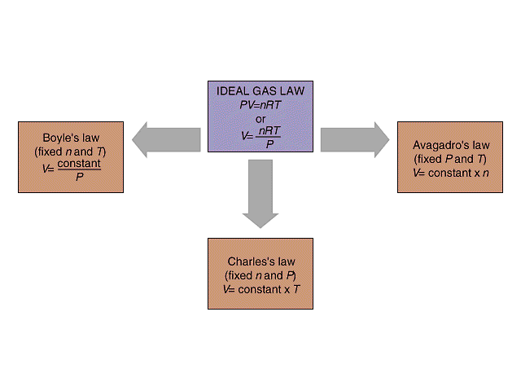
Isobaric process: pressure constant
Isochoric process: volume constant
Isothermal process: temperature constant
P₁ V₁ = P₂ V₂
P V
V₁ / n₁ = V₂ / n₂
V n
Standard Conditions (STP)
273 K, 1.0 atm,
R = 0.08206 L atm/ K mol
@STP
1 mole of any “ideal” gas has
a volume of 22.4 Liters.
Combined Gas Law
P₁V₁ / T₁ = P₂V₂ / T₂
V₁ / T₁ = V₂ / T₂
V T

Slide 12
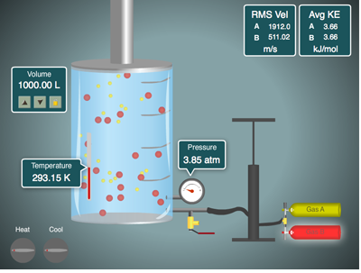
Ideal Gas Law
Simulator
http://ch301.cm.utexas.edu/simulations/gas-laws/GasLawSimulator.swf

Slide 13
Hydrogen & the Ideal Gas Law
n H₂(g) = PV / RT
n = moles H₂(g)
P H₂(g) = pressure of H₂(g) in atm (mm Hg → atm)
V = experimental volume (mL→ L)
T = experimental temperature (ºC → K)
Mg(s) + 2HCl(aq) → MgCl₂(aq) + H₂ (g)
Zn(s) + 2HCl(aq) → ZnCl₂(aq) + H₂ (g)

Slide 14
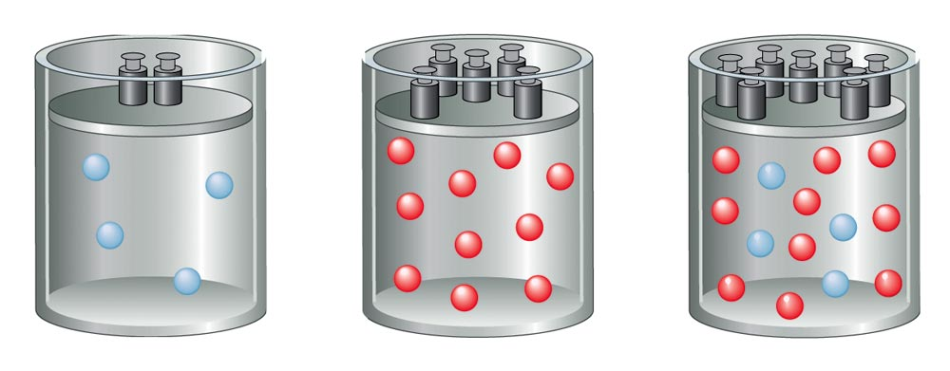
Total Pressure:
Sum of the Partial Pressures
For a mixture of gases, the total pressure is the sum of the pressures of each gas in the mixture.
  P_{Total} = P₁ + P₂ + P₃ + . . .
P_{Total} ∝ n _{Total}
n_{Total} = n₁ + n₂ + n₃ + . . .

Slide 15
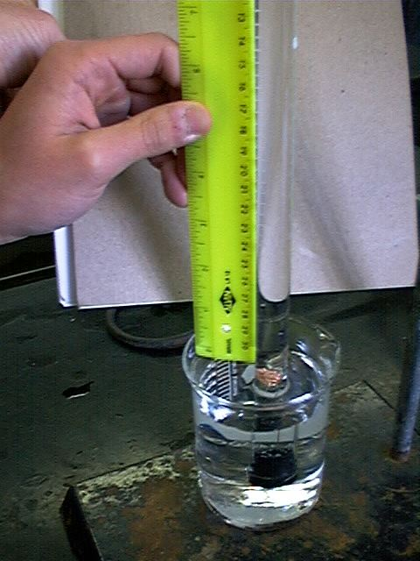
P H₂(g) = P Total (barometric) - P H₂O (g) [TABLE] - P HCl (g)
P HCl (g) =
HCl Height (mm) ÷ 12.95
___________
Density Hg is 12.95 times > density HCl(aq)
P HCl (g) =
HCl Height (mm) x 0.0772
___________
Density Hg is 12.95 times > density HCl(aq)
0.772 mm Hg/cm of acid solution

Slide 16
Ideal Gas Law:
Moles / Avogadro’s Law
n H₂(g) = PV / RT
n = moles H₂(g)
P H₂(g) = pressure of H₂(g) in atm (mm Hg → atm)
P H₂(g) = P Total (barometric) - P H₂O (g) [TABLE] - P HCl (g)
V = experimental volume (mL→ L)
T = experimental temperature (ºC → K)
R = 0.082057338 L atm K⁻¹ mol⁻¹ (constant)
Mg(s) + 2HCl(aq) → MgCl₂(aq) + H₂ (g)
Zn(s) + 2HCl(aq) → ZnCl₂(aq) + H₂ (g)

Slide 17
Refer to Report Form Part I: (Example uses Zinc.)
Mole Calculations:
Stoichiometry Calculation
Ideal Gas Law Calculations
Comparison (% Error)
Zn(s) + 2HCl(aq) → ZnCl₂(aq) + H₂ (g)

Slide 18
Stoichiometry
Moles Hydrogen / Mass of Zinc
(Part I: Zinc Calculation)
Zn(s) + 2HCl(aq) → ZnCl₂(aq) + H₂ (g)
mol H₂(g) = mol Zn(s)
mass (g) Zn(s) = mol Zn(s) x Molar Mass Zn(s)

Slide 19
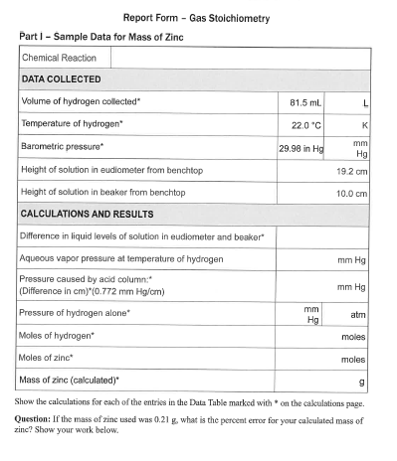
Zinc Example Calculation
Complete Report Form pg. 58 Part I:
Mole Calculations:
Stoichiometry Calculation
Ideal Gas Law Calculations
Comparison (% Error)
Zn(s) + 2HCl(aq) → ZnCl₂(aq) + H₂ (g)

Slide 20
Moles : Ideal Gas Law
(Part I: Zinc Calculation Example)
Zn(s) + 2HCl(aq) → ZnCl₂(aq) + H₂ (g)
n H₂(g) = PV / RT
n = moles H₂(g)
P H₂(g) = pressure of H₂(g) in atm (mm Hg → atm)
P H₂(g) = P Total (barometric) - P H₂O (g) [TABLE] - P HCl (g)
V = experimental volume (mL→ L)
T = experimental temperature (ºC → K)
R = 0.082057338 L atm K⁻¹ mol⁻¹

Slide 21
Moles : Ideal Gas Law
(Part I: Zinc Calculation Example)
Zn(s) + 2HCl(aq) → ZnCl₂(aq) + H₂ (g)
n H₂(g) = PV / RT
V = experimental volume (mL→ L)
R = 0.082057338 L atm K⁻¹ mol⁻¹

Slide 22
Moles : Ideal Gas Law
(Part I: Zinc Calculation Example)
Zn(s) + 2HCl(aq) → ZnCl₂(aq) + H₂ (g)
n H₂(g) = PV / RT
V = experimental volume (mL→ L)
T = experimental temperature (ºC → K)
R = 0.082057338 L atm K⁻¹ mol⁻¹

Slide 23
Moles : Ideal Gas Law
(Part I: Zinc Calculation Example)
Zn(s) + 2HCl(aq) → ZnCl₂(aq) + H₂ (g)
n H₂(g) = PV / RT
V = experimental volume (mL→ L)
T = experimental temperature (ºC → K)
P H₂(g) = pressure of H₂(g) in atm (mm Hg → atm)
P H₂(g) = P Total (barometric) - P H₂O (g) [TABLE] - P HCl (g)
R = 0.082057338 L atm K⁻¹ mol⁻¹

Slide 24
Moles : Ideal Gas Law
Part I: Hydrogen Calculation, (Refer to Form’s Data)
Zn(s) + 2HCl(aq) → ZnCl₂(aq) + H₂ (g)
n H₂(g) = PV / RT
n = moles H₂(g)
P H₂(g) = pressure of H₂(g) in atm (mm Hg → atm)
P H₂(g) = 29.98 inches Hg (barometric) - 19.8 mm Hg H₂O (g) [TABLE] - P HCl (g)
P HCl (g)
R = 0.082057338 L atm K⁻¹ mol⁻¹
19.2 cm
10.0 cm

Slide 25
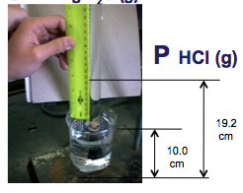
P H₂(g) = P Total (barometric) - P H₂O (g) [TABLE] - P HCl (g)
P HCl (g) =
19.2 cm Hg - 10.0 cm Hg = 92 mm Hg
HCl Height (mm) x 0.0772
= 7.1 mm Hg
__________
Density Hg is 12.95 times > density HCl(aq)
P HCl (g) =
19.2 cm Hg - 10.0 cm Hg = 92 mm Hg
HCl Height (mm) ÷ 12.95
= 7.1 mm Hg
___________
Density Hg is 12.95 times > density HCl(aq)
P HCl (g)
0.772 mm Hg/cm of acid solution

Slide 26
P H₂(g) = 761.5 mm Hg (barometric)
- 19.8 mm Hg H₂O (g) - 7.1 mm Hg HCl (g)
= 734.6 mm Hg
= 734.6 mm Hg / 760.0 mm Hg / 1.000 atm
= 0.9666 atm

Slide 27
Moles : Ideal Gas Law
(Part I: Hydrogen Calculation)
Zn(s) + 2HCl(aq) → ZnCl₂(aq) + H₂ (g)
n H₂(g) = PV / RT
n = moles H₂(g)
P H₂(g) = 0.9666 atm
V = 0.0815 L
T = 295.1 K
R = 0.08206 L atm K⁻¹ mol⁻¹
n H₂(g) =
0.00325 moles H₂(g) = 0.00325 moles Zn(s)

Slide 28
% Error
Theoretical Mass Zinc vs. Experimental
(Part I: Calculation)
Zn(s) + 2HCl(aq) → ZnCl₂(aq) + H₂ (g)
mass (g) Zn(s) = mol Zn(s) x Molar Mass Zn(s)
= 0.00325 moles Zn(s) x 65.37 g/mol Zn(s)
experimental grams Zn(s) - theoretical grams Zn(s)
_________________________________________________________________________________________________________--________________
theoretical grams Zn(s)
% Error =
x 100
0.213 g - 0.21 g
___________________________________________________
0.21 g
=
x 100
= 1.4 %
Bring completed Report Forms to Dr. R. to get Mg(s) sample(s).

Slide 29
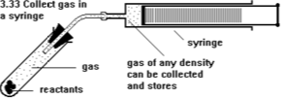
Molar Mass of any Gas
(Hydrogen for example)
PV = n RT
n = g of gas/ MM _{gas} [MM _{gas} = g/mol]
PV = (g of gas/ MM _{gas})RT
MM _{gas} = g of gas/V (RT/P)
Density of gas
MM _{gas} = g of gas/V (RT/P)
MM _{gas} = density of gas (RT/P)

Slide 30
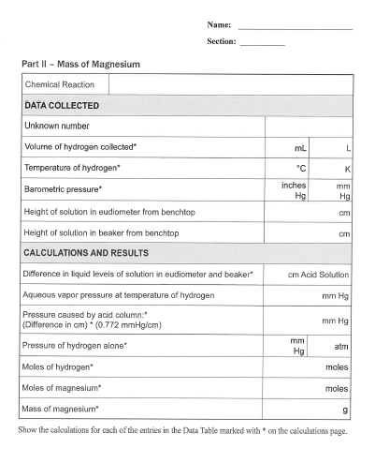
(Part II) Magnesium
Mole Calculations:
Stoichiometry Calculation
Ideal Gas Law Calculations
Comparison (% Error)
Mg(s) + 2HCl(aq) → MgCl₂(aq) + H₂ (g)
Get equipment from stockroom and complete data acquisition for Part II.
Have individual Report Forms checked before leaving lab today.

